Slide 1

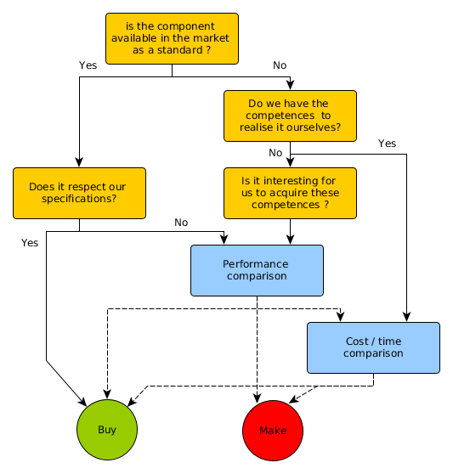
Make or buy decisions
Arbitrage between make and buy
Arbitrage between make and buy
Diagram to represent the procedure to arbitrate decisions between make or buy.

